Slide 1
Embodied AI week 10
- Shaoqin Li

Slide 2
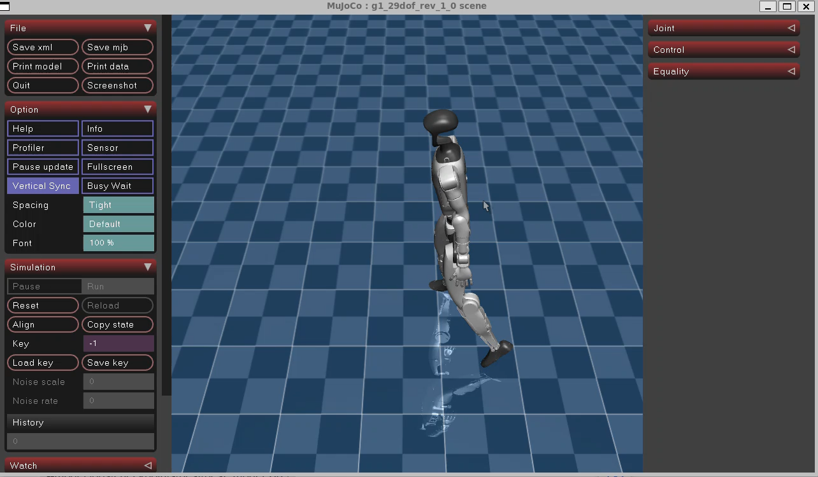
Training result

Slide 3
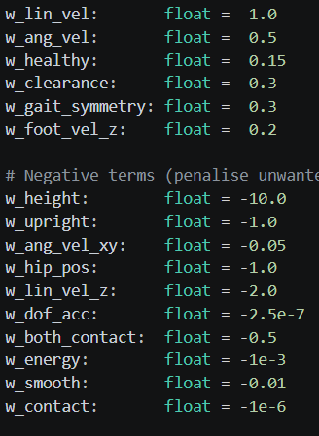
Reflection
As we can see, there are some movements on the legs this time. But there are 3 major issues remaining:
Wide leg distance
Spinning
Not Walking straight

Slide 4
How to fix
Leg stance
The reward related to the leg distance is w_hip_pos, which I set it as a penalty. But it seems like I either not punish it hard enough or the array for this penalty is wrong, making it punish the wrong joints
Spinning
w_ang_vel_xy is the issue, it means the agent will get reward no matter what position it is at
Not walking Straight
My velocity command is in the world frame, but the agent doesn’t know which direction is x.

Slide 5
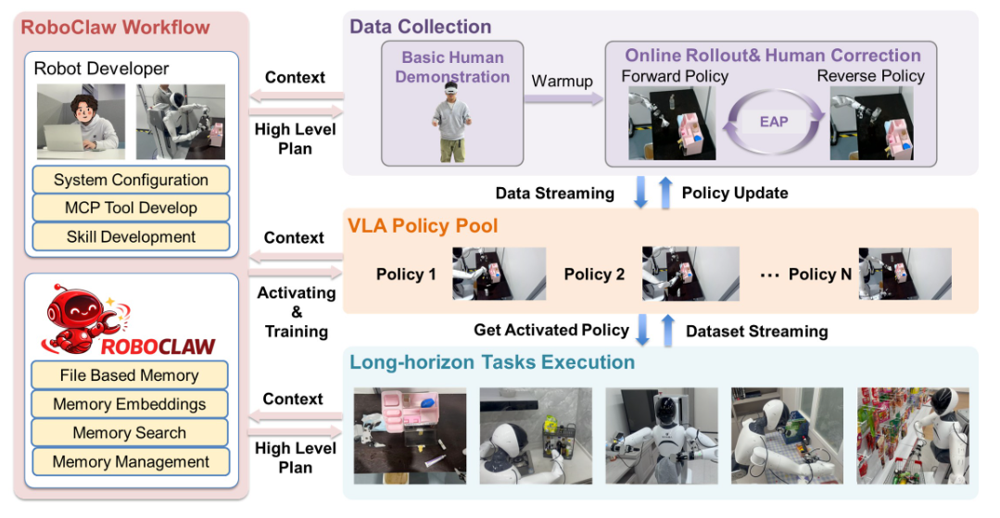
RoboClaw: An Agentic Framework for Scalable Long-Horizon Robotic Tasks
RoboClaw is an agentic robotics framework for long-horizon manipulation created by groups from AgiBot, National University of Singapore and Shanghai Jiao Tong University. It uses a vision-language model as the high-level controller and keeps the same agent in the loop during data collection, policy learning, and deployment.
Instead of treating those stages as separate systems, RoboClaw lets the agent reason over context, choose skills, monitor execution, and feed deployment experience back into training.

Slide 6
Core Problems
Long Horizon Tasks are difficult
In long-horizon tasks, small errors do not stay local — they propagate and compound through subsequent steps. This makes robustness to distribution shift and consistent inter-policy semantics critically important. Existing methods lack a unified mechanism to achieve this.
The Fragmentation Problem in Existing Pipelines
Reset dependency: Manual environment resets are required between data collection episodes, imposing high human labor costs and limiting scalability.
Train-deploy mismatch: When data collection, model training, and execution are driven by independent processes, the training data distribution diverges from deployment conditions — causing cascading failures in multi-step tasks.
Multi-policy brittleness: Different modules for data gathering, policy learning, and orchestration introduce mismatched semantic representations, making long-horizon task chains inherently fragile

Slide 7
Framework -Unified VLM-Driven Agent Architecture
RoboClaw follows a single interaction paradigm: a user sends a natural-language task instruction, and the robot autonomously reasons and executes. The same VLM controller governs data collection, iterative policy refinement, and final task deployment — ensuring semantic consistency across all stages.

Slide 8
Framework-Entangled Action Pairs (EAP)
The central technical contribution of RoboClaw is the Entangled Action Pair (EAP) mechanism. For each manipulation skill, RoboClaw pairs:
Forward action: A forward manipulation behavior (e.g., pick up an object)
Inverse action: A complementary inverse recovery action that returns the environment to a reusable starting state (e.g., place the object back)
These paired actions alternate execution under agent control, forming a self-resetting loop. This enables the robot to practice the same skill continuously without any human intervention to reset the scene. The result is autonomous, on-policy data collection at scale — eliminating one of the most labor-intensive bottlenecks in robotics research.

Slide 9
Framework-Dynamic Skill Orchestration at Deployment
At inference time, the same VLM agent performs high-level task reasoning and dynamically schedules learned skill primitives based on the current environmental context. Rather than following a static, pre-planned skill sequence, the agent monitors subtask states in real time, validates execution conditions, and triggers recovery behaviors when deviations are detected. This makes the system robust to partial failures and environmental perturbations

Slide 10
Results
RoboClaw was evaluated on real-world manipulation tasks and demonstrated substantial improvements over conventional open-loop baselines:
Task success: Average success rate improved by 25% over baseline methods on long-horizon tasks.
Efficiency: Human time investment reduced by 53.7% across the full robot lifecycle (data collection, training, deployment).
Robustness: Improved multi-policy robustness compared to conventional pipelines, with fewer cascading failures.

Slide 11
Why it matters to us
RoboClaw represents a meaningful shift in how the robotics community thinks about the learning pipeline. Rather than treating data collection, training, and deployment as independent engineering concerns, RoboClaw demonstrates that unifying them under a single agent — with consistent semantics and self-resetting data loops — yields measurable gains in both performance and scalability. The 53.7% reduction in human effort is particularly significant for real-world deployment, where operator time is often the primary cost bottleneck.

